Slide 1
Input Tokenizers
Plaban Kumar Bhowmick
Department of AI
plaban@ai.iitkgp.ac.in

Slide 2
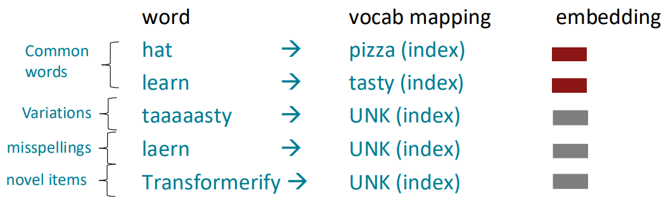
Input Tokens: Many Words are Rare
We assume a fixed vocab of tens of thousands of words, built from the training set.
All novel words seen at test time are mapped to a single [UNK]

Slide 3
Input Tokens: Sub-Word
The dominant modern paradigm is to learn a vocabulary of parts of words (subword tokens)
At training and testing time, each word is split into a sequence of known subwords
Byte-pair encoding
Common words end up being a part of the subword vocabulary
Rarer words are split into (sometimes intuitive, sometimes not) components.
In the worst case, words are split into as many subwords as they have characters.

Slide 4
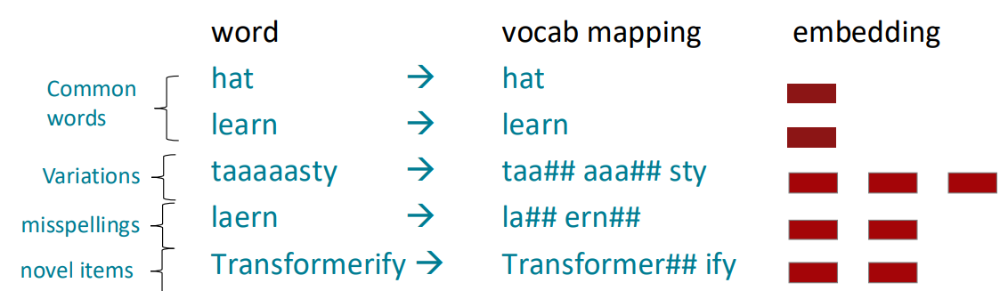
Input Tokens: Sub-Word

Slide 5
Tokenization Strategies
Commonly used tokenizers
Byte Pair Encoding (BPE) tokenizer
Wordpiece Tokenizer
SentencePiece Tokenizer
General steps
Step 1: Use a corpora to train the tokenizer (i.e., segmentation rules)
Step 2: Use the learned segmentation rules to tokenize any test input

Slide 6
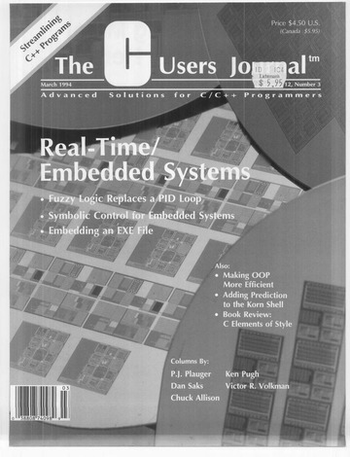
Byte Pair Encoding (BPE)
Philip Gage
Vocabulary
Symbol | Represents
a | a
b | b
c | c
d | d
aaabdaaabac
ZabdZabac
ZYdZYac
Z | aa
Y | ab
XdXac
X | ZY
A new algorithm for data compression

Slide 7
Byte Pair Encoding (BPE): Training
Tokenization
Pat pat cat sat on mat cat sat on mat with pat
Convert text to lowercase. Replace whitespace with a special symbol ␣
[pat␣], [pat␣], [cat␣], [sat␣], [on␣], [mat␣], [cat␣], [sat␣], [on␣], [mat␣], [with␣], [pat␣]
Tokenize at every character boundary. Build vocabulary with each unique character
INITIAL TOKENS:
[['p', 'a', 't', '␣'], ['p', 'a', 't', '␣'], ['c', 'a', 't', '␣'], ['s', 'a', 't', '␣'],
['o', 'n', '␣'], ['m', 'a', 't', '␣'], ['c', 'a', 't', '␣'], ['s', 'a', 't', '␣'],
['o', 'n', '␣'], ['m', 'a', 't', '␣'], ['w', 'i', 't', 'h', '␣'], ['p', 'a', 't', '␣']]
INITIAL VOCAB:
['a', 'c', 'h', 'i', 'm', 'n', 'o', 'p', 's', 't', 'w', '␣']

Slide 8
Byte Pair Encoding (BPE)
Token | Frequency
a | 9
c | 2
h | 1
i | 1
m | 2
n | 2
o | 2
p | 3
s | 2
w | 1
t | 10
␣ | 12
INITIAL TOKENS:
[['p', 'a', 't', '␣'], ['p', 'a', 't', '␣'], ['c', 'a', 't', '␣'], ['s', 'a', 't', '␣'],
['o', 'n', '␣'], ['m', 'a', 't', '␣'], ['c', 'a', 't', '␣'], ['s', 'a', 't', '␣'],
['o', 'n', '␣'], ['m', 'a', 't', '␣'], ['w', 'i', 't', 'h', '␣'], ['p', 'a', 't', '␣']]
INITIAL VOCAB:
['a', 'c', 'h', 'i', 'm', 'n', 'o', 'p', 's', 't', 'w', '␣']

Slide 9
Byte Pair Encoding (BPE): Training
Merge Operation
Merge 1, for getting bigrams
Token | Frequency
a | 9
c | 2
h | 1
i | 1
m | 2
n | 2
o | 2
p | 3
s | 2
w | 1
t | 10
␣ | 12
at | 9
TOKENS: [[p, a, t, ␣], [p, a, t, ␣], [c, a, t, ␣], [s, a, t, ␣], [o, n, ␣],
[m, a, t, ␣], [c, a, t, ␣], [s, a, t, ␣], [o, n, ␣],
[m, a, t, ␣], [w, i, t, h, ␣], [p, a, t, ␣]]
VOCAB: [a, c, h, i, m, n, o, p, s, t, w, ␣]
PAIRS: (p,a)=3 | (a,t)=9 | (t,␣)=9 | (c,a)=2 | (s,a)=2 | (o,n)=2 | (n,␣)=2 | (m,a)=2 | (w,i)=1 | (i,t)=1 | (t,h)=1 | (h,␣)=1
SORTED: (a,t)=9 | (t,␣)=9 | (p,a)=3 | (c,a)=2 | (s,a)=2 | (o,n)=2 | (n,␣)=2 | (m,a)=2 | (w,i)=1 | (i,t)=1 | (t,h)=1 | (h,␣)=1
MERGE: (a,t) → at
UPDATED TOKS: [[p, at, ␣], [p, at, ␣], [c, at, ␣], [s, at, ␣],
[o, n, ␣], [m, at, ␣], [c, at, ␣], [s, at, ␣],
[o, n, ␣], [m, at, ␣], [w, i, t, h, ␣], [p, at, ␣]]
Whenever we are taking merge decision, we add that item in the vocab
UPDATED VOCAB: [a, c, c, h, i, m, n, o, p, s, t, w, ␣, at]
MERGE RULES: [(a,t) → at]

Slide 10
Byte Pair Encoding (BPE): Training
Merge 2, for getting trigrams
PAIRS: (p, at)=3 | (at, ␣)=9 | (c, at)=2 | (s, at)=2 | (o, n)=2 | (n, ␣)=2 | (m, at)=2 | (w, i)=1 |
(i, t)=1 | (t, h)=1 | (h, ␣)=1
SORTED: (at, ␣)=9 | (p, at)=3 | (c, at)=2 | (s, at)=2 | (o, n)=2 | (n, ␣)=2 | (m, at)=2 |
(w, i)=1 | (i, t)=1 | (t, h)=1 | (h, ␣)=1
MERGE: (at, ␣) → at␣
UPDATED TOKS: [[p, at␣], [p, at␣], [c, at␣], [s, at␣], [o, n, ␣], [m, at␣], [c, at␣], [s, at␣],
[o, n, ␣], [m, at␣], [w, i, t, h, ␣], [p, at␣]]
UPDATED VOCAB: [a, at, at␣, c, h, i, m, n, o, p, s, t, w, ␣]
MERGE RULES: [(a, t) → at, (at, ␣) → at␣]
We first insert unigrams in the vocabulary, then bigrams, and then trigrams and so on

Slide 11
Byte Pair Encoding (BPE): Training
Merge 3
PAIRS: (p, at␣)=3 | (c, at␣)=2 | (s, at␣)=2 | (o, n)=2 | (n, ␣)=2 | (m, at␣)=2 | (w, i)=1 | (i, t)=1 | (t, h)=1 | (h, ␣)=1
SORTED: (p, at␣)=3 | (c, at␣)=2 | (s, at␣)=2 | (o, n)=2 | (n, ␣)=2 | (m, at␣)=2 | (w, i)=1 | (i, t)=1 |
(t, h)=1 | (h, ␣)=1
MERGE: (p, at␣) → pat␣
UPDATED TOKS: [[pat␣], [c, at␣], [s, at␣], [o, n, ␣], [m, at␣], [c, at␣], [s, at␣], [o, n, ␣],
[m, at␣], [w, i, t, h, ␣], [pat␣]]
UPDATED VOCAB: [a, at, at␣, c, h, i, m, n, o, p, pat␣, s, t, w, ␣]
MERGE RULES: [(a, t) → at, (at, ␣) → at␣, (p, at␣) → pat␣]

Slide 12
Byte Pair Encoding (BPE): Training
Merge 12
MERGE RULES:
[(a, t) → at,
(at, ␣) → at␣,
(p, at␣) → pat␣,
(c, at␣) → cat␣,
(s, at␣) → sat␣,
(o, n) → on,
(on, ␣) → on␣,
(m, at␣) → mat␣,
(w, i) → wi,
(wi, t) → wit,
(wit, h) → with,
(with, ␣) → with␣]
PAIRS: (with, ␣)=1
SORTED: (with, ␣)=1
MERGE: (with, ␣) → with␣
UPDATED TOKS:
[[pat␣], [pat␣], [cat␣], [sat␣], [on␣], [mat␣], [cat␣], [sat␣], [on␣], [mat␣], [with␣], [pat␣]]
UPDATED VOCAB:
[a, at, at␣, c, cat␣, h, i, m, mat␣, n, o, on, on␣, p, pat␣, s, sat␣, t, w, wi, wit, with, with␣, ␣]
We stop when the longest possible length of token has been achieved.

Slide 13
Byte Pair Encoding (BPE): Inference
UPDATED VOCAB:
[a, at, at␣, c, cat␣, h, i, m, mat␣, n, o, on, on␣, p, pat␣, s, sat␣, t, w, wi, wit, with, with␣, ␣]
MERGE RULES:
[(a, t) → at],
[(at, ␣) → at␣],
[(p, at␣) → pat␣],
[(c, at␣) → cat␣],
[(s, at␣) → sat␣],
[(o, n) → on],
[(on, ␣) → on␣],
[(m, at␣) → mat␣],
[(w, i) → wi],
[(wi, t) → wit],
[(wit, h) → with],
[(with, ␣) → with␣]
WORD: pat␣
TOKENS: [p, a, t, ␣]
PAIRS: (p, a) | (a, t) | (t, ␣)
MERGE 1: [p, at, ␣]
PAIRS: (p, at) | (at, ␣)
MERGE 2: [p, at␣]
PAIRS: (p, at␣)
MERGE 3: pat␣
WORD: patio␣
TOKENS: [p, a, t, i, o, ␣]
PAIRS: (p, a) | (a, t) |
(t, i) | (i,o) | (o, ␣)
MERGE 1: [p, at, i, o, ␣]
PAIRS: (p, at) | (at, i) | (i,o) |
(o, ␣)
TOK: [p, at, i, o, ␣]
WORD: paty␣
TOKENS: [p, a, t, y, ␣]
PAIRS: (p, a) | (a, t) |
(t, y) | (y, ␣)
MERGE 1: [p, at, y, ␣]
PAIRS: (p, at) | (at, y) |
(y, ␣)
TOK: [p, at, y, ␣]
TOK: [p, at, [UNK], ␣]
[ Patio_ ] isn’t there in the training data. So, we either would have used it as UNK since it doesn’t appear in vocab, or we can break it down into subwords to match some subwords with the vocabulary and get our final tokenization
In the corpora, [ pat_ ]is a very frequent thing, so there is no need to break that..
Since, ‘y’ isn’t there in vocabulary so we have to replace it with [UNK] token
Why do we need ‘␣’ ?
estonia vs. highest
How do we get rid of [UNK]?
Byte-Level BPE (BBPE)

Slide 14
With BPE, we have a risk of getting a [ UNK ] token,
Simple solution: include all characters of the known Alphabet system to be included in your vocabulary.
Why we need that dash token ?
Let’s say we have :
estonia vs. highest
In the word highest , est acts like suffix, and after suffix we have a blank / suffix always ends with blank.
So, ‘est’ of ‘estonia’ is represented as ‘est’ , since here ‘est’ is prefix
And ‘est’ of ‘highest’ is represented as ‘est_’ , since here ‘est’ is suffix and suffix always ends with blank.
BPE doesn’t care about linguistics; we can break a word at any point of time based on frequency.

Slide 15





Word_Piece Tokenizer
Similar algorithm as BPE
Scoring a pair during merge step is different than BPE
Token | Frequency
a | 9
c | 2
h | 1
i | 1
m | 2
n | 2
o | 2
p | 3
s | 2
w | 1
t | 10
␣ | 12
at | 9
This is some kind of normalization of frequency value. This is what we call as Mutual Information, how mutually ‘a’ and ‘b’ are dependent on each other.
$$score\left(a,b\right)=\frac{freq(ab)}{freq\left(a\right)∗freq(b)}$$
PAIRS: (p,a)=3 | (a,t)=9 | (t,␣)=9 | (c,a)=2 | (s,a)=2 | (o,n)=2 | (n,␣)=2 | (m,a)=2 | (w,i)=1 | (i,t)=1 | (t,h)=1 | (h,␣)=1
$$score\left(p,a\right)=\frac{freq(pa)}{freq\left(p\right)∗freq(a)}=\frac{3}{3∗9}=\frac{1}{9}$$
Earlier, we were using un-normalized frequency, but now we are using a normalized frequency, and there is a chance that we may get different kind of segmentation rules than what we derived in BPE.
$$score\left(a,t\right)=\frac{freq(at)}{freq\left(a\right)∗freq(t)}=\frac{9}{9∗10}=\frac{1}{10}$$
$$score\left(c,a\right)=\frac{freq(2)}{freq\left(2\right)∗freq(9)}=\frac{9}{9∗10}=\frac{1}{9}$$
Hugging → ['Hugg', '##i', '##n', '##g']
$$score\left(w,i\right)=\frac{freq(wi)}{freq\left(w\right)∗freq(i)}=\frac{1}{1∗1}=1$$
They use ‘#’, to designate that, ‘##i’ is the token that is inside the main word.
https://huggingface.co/learn/llm-course/en/chapter6/6?fw=pt

Slide 16
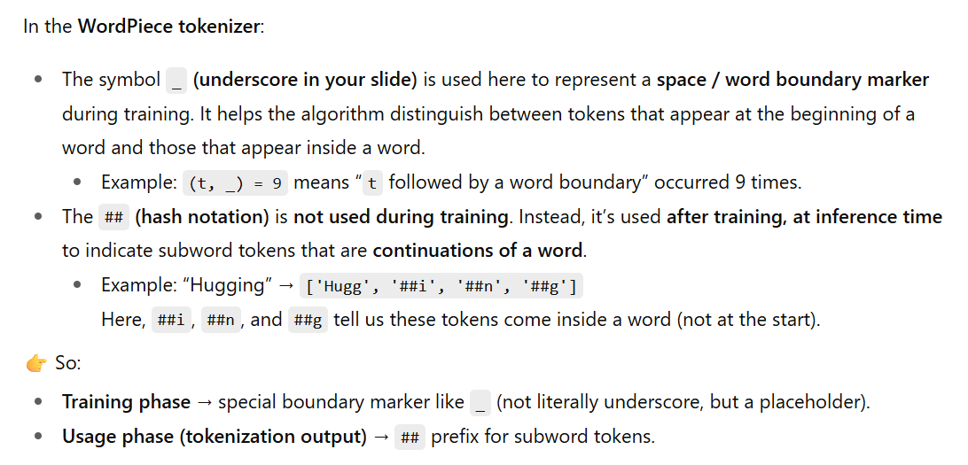

Slide 17
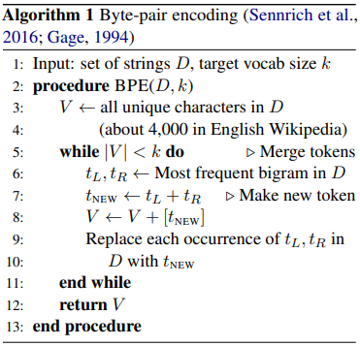
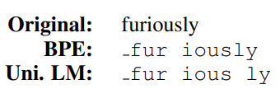

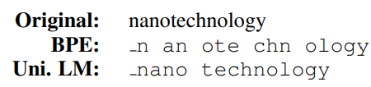

Sentence_Piece Tokenizer
Our target is to get the vocabulary size of ‘k’, and we try to find out the most frequent bigrams.
BPE and Word_Piece tokenizers follow a greedy approach
Suboptimal tokenization
Quite often meaningless
Ideally, it should come up with uni. LM tokenization, but BPE gives illogical tokenization
The problem: BPE or Word-Piece do not judge to what extent
the new vocabulary represents the training
corpora
Bostrom and Durrett, Byte Pair Encoding is Suboptimal for Language Model Pretraining

Slide 18
SentencePiece Tokenizer: Idea
Start with a large vocabulary [will contain all characters, bi-grams, etc.]
Repeat the reduction step
Remove some entries
Reduce the vocab
Check whether the reduced
vocabulary represents the
training data more appropriately
To what extent, does a vocabulary represent a given training data?

Slide 19
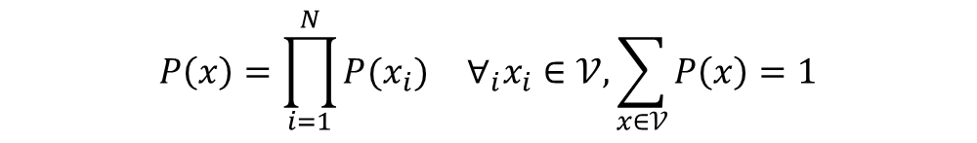

SentencePiece: Unigram Tokenizer
To what extent, does a vocabulary represent a given training data?
What is the likelihood of the training data given a vocabulary?
Probabilistic Language Model:
$$P\left(x_{1}, x_{2}, …., x_{N}\right)=P\left(x_{1}\right)×P\left(x_{2} | x_{1}\right)×P\left(x_{3} | x_{1}, x_{2}\right)×…×P\left(x_{N}\right|x_{1}, x_{2}, …,x_{N−1})$$
Unigram Language Model:
$$P\left(x_{1}, x_{2}, …., x_{N}\right)=P\left(x_{1}\right)×P(x_{2})×P(x_{3})×…×P(x_{N})$$
We use an unigram LM based on the assumption that tokens are independent
For a given sequence ${x=x}_{1}, x_{2}, …., x_{N}$:
$$P\left(x\right)=\prod_{i=1}^{N}{P(x_{i})} ∀_{i}x_{i}∈𝒱, \sum_{x∈𝒱}{P\left(x\right)=1}$$
Should prob(sequence,x) be = 1 ?
Kudo, Subword Regularization: Improving Neural Network Translation Models with Multiple Subword Candidates (Section 3)
Chung, Segmentation for Natural Language Modeling

Slide 20
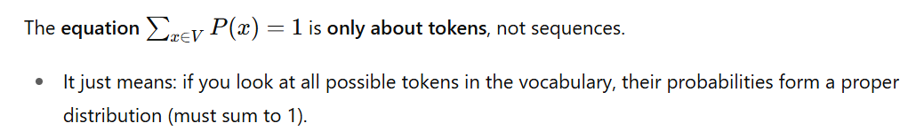

Slide 21
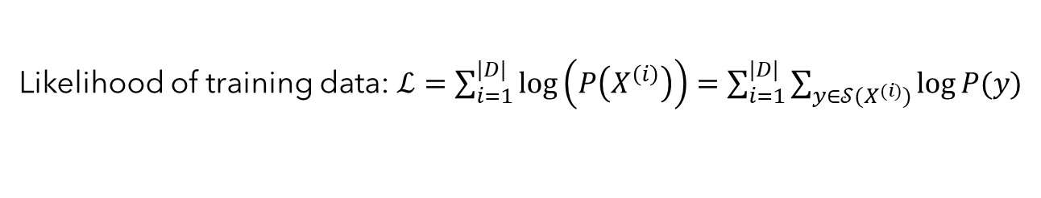
SentencePiece: Unigram Tokenizer
What is the likelihood of the training data $(D)$ given a vocabulary $(𝒱)$?
The Training Data: $D=\{X^{\left(1\right)}, X^{\left(2\right)}, …, X^{(\left|D\right|)}\}$
Segmentation: $𝒮(X)$ conditioned on vocabulary $𝒱$
Likelihood of training data: $ℒ=\sum_{i=1}^{|D|}{\log\left(P\left(X^{\left(i\right)}\right)\right)}=\sum_{i=1}^{|D|}{\sum_{y∈𝒮(X^{(i)})}{\log{P(y)}}}$
To represent the training data better, $ℒ$ has to be maximized
Maximum Likelihood Estimation (MLE) method
What does it mean to maximize?
Maximizing the quantity $P\left(X^{\left(i\right)}\right)$
An element $X$ may have several ways to segment
$𝒱$=["b", "g", "h", "n", "p", "s", "u", "ug", "un", "hug"]
$𝒮\left(\text{hugs}\right)=$ { ["hug", "s"], ["h", "ug", "s"], ["h", "u", "g", "s"]}
Find the segmentation with highest likelihood value

Slide 22
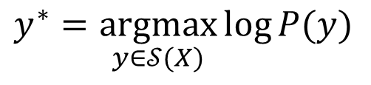
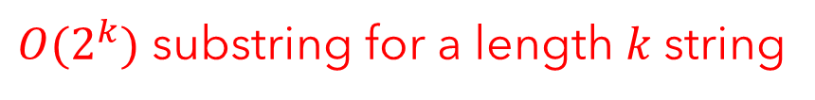
SentencePiece: Unigram Tokenizer
Find the segmentation with highest likelihood value
$$y^{∗}=\underset{y∈𝒮(X)}{argmax}{\log{P(y)}}$$
A naïve approach
Enumerate all possible segmentations
$O(2^{k})$ substring for a length $k$string
Calculate likelihood of each segmentation $y$
Find the segmentation ($y^{∗}$) with maximum likelihood
Viterbi Decoding in rescue
Dynamic programming approach for computing the probability of the most likely sequence out of combinatorically many sequences
https://guillaume-be.github.io/2020-05-30/sentence_piece

Slide 23
Unigram Tokenizer: Viterbi Decoding
Likelihood
=
Likelihood (BestSeg( ))
PREFIX
CHAR
PREFIX
+
Likelihood ( )
CHAR
Viterbi Decoding ensures significant amount of pruning segmentation
options with less likelihood

Slide 24
Unigram Tokenizer: Viterbi Decoding
Token (x) | log(P(x))
b | -5.6
h | -4.8
e | -3.2
j | -6.4
a | -2.9
f | -1.3
r | -6.7
bh | -6.2
bhe | -8.3
ja | -7.5
fr | -5.5
ry | -2.3
y | -2.5
fry | -9.6
b h e j a f r y
Forward pass
Backward pass
-5.6
-5.6-4.8=-10.4
b
h
-6.2
-6.2-3.2=-9.4
-14.7-2.8=-17.5
-8.3-6.4=-14.7
j
a
bh
e
-15.8-1.3=-17.1
-17.1-6.7=-23.8
-8.3
f
r
bhe
-8.3-7.5=-15.8
-15.8-5.5=-21.3
-21.3-2.5=-23.8
ja
fr
y
Now, we have which segmentation maximizes the likelihood of the training corpora given the vocabulary. This is important for us since we want to check the effect of the removal of individual vocab items from the vocabulary. We want to come up with vocab that is good, and the probability of each of the vocab items has to be estimated.
So we are performing joint optimization on the size and composition of the vocab and probability values of vocab items. This joint optimization is hard and solved using EMA
-15.8-9.6=-25.4
fry

Slide 25
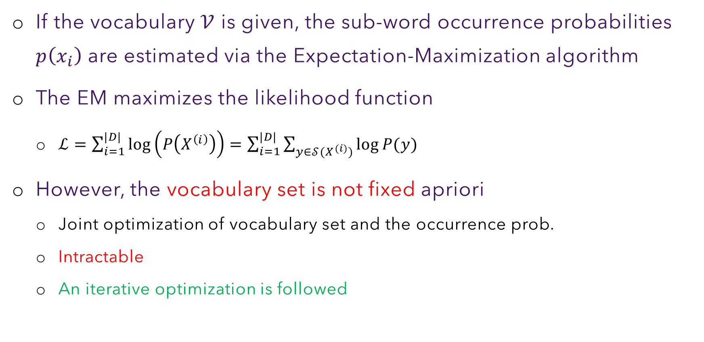
Unigram Tokenizer: Algorithm
If the vocabulary $𝒱$ is given, the sub-word occurrence probabilities $p\left(x_{i}\right)$ are estimated via the Expectation-Maximization algorithm
The EM maximizes the likelihood function
$ℒ=\sum_{i=1}^{|D|}{\log\left(P\left(X^{\left(i\right)}\right)\right)}=\sum_{i=1}^{|D|}{\sum_{y∈𝒮(X^{(i)})}{\log{P(y)}}}$
However, the vocabulary set is not fixed apriori
Joint optimization of vocabulary set and the occurrence prob.
Intractable
An iterative optimization is followed
In EMA, in the Gaussian mixture model, we have observations drawn from some unknown probability distribution, with the assumption that this probability is mixture of guassians.
We can just draw some observations, and we have to estimate the params of the Gaussian function, we start with some observations, and then feed that to the model, try to compute params of the model and we want to maximize the likelihood of the observations, doing in iterative loop.
Expectation of the true params and then maximization of observed data based on that estimate the params.

Slide 26
Unigram Tokenizer: Algorithm
Expectation-Maximization:
Some observations drawn from an unknown distribution
Start with an initial guess of the parameters of the distribution
[Expectation] Estimate the maximum likelihood (MLE) of the observations
[Maximization] Figure out the model parameters that maximizes the MLE
Initialize a large seeding subword vocabulary from the training corpus
[Expectation] Estimate each subword probability by the corresponding frequency counts in the corpus
[Maximization] Use Viterbi to segment the corpus, returning the optimal segments
Compute the loss of each new subword from optimal segments
Shrink the vocabulary size by dropping the subwords with top X% smallest losses
Repeat step 2 to 5 until the vocabulary size reaches a desired number
Loss of a subword in step 4 is the reduction in overall training corpus segment likelihood if that subword is removed from the current vocabulary.

Slide 27
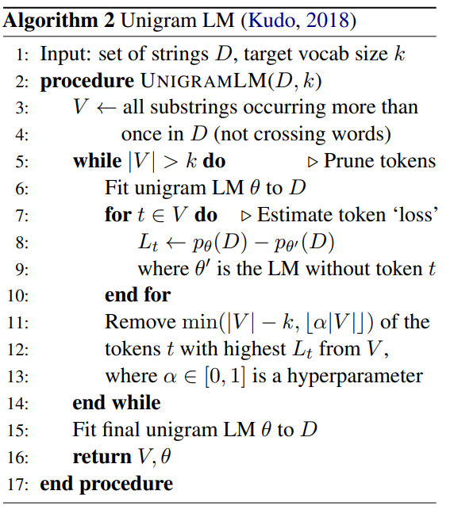
Unigram Tokenizer: Training Algorithm
We don’t have access to V’s and probabilities of ‘V’, but we try to compute things iteratively, and we start with any vocab (maybe all possible substrings).
we can estimate the probability of those vocab items using training corpora, and then we want to maximize the likelihood of ..
We want to remove some of the tokens from the vocab. We have revised vocabulary, we have new observations, based on that we
See new probability values, and whether new vocabulary models the training corpora in a better way and we do that iteratively.

Slide 28
Unigram Tokenizer: Running Example
Training Corpora
("hug", 10), ("pug", 5), ("pun", 12), ("bun", 4), ("hugs", 5)
Starting Vocabulary (All strict substrings)
["h", "u", "g", "hu", "ug", "p", "pu", "n", "un", "b", "bu", "s", "hug", "gs", "ugs"]
Frequencies of the subwords
("h", 15) ("u", 36) ("g", 20) ("hu", 15) ("ug", 20) ("p", 17) ("pu", 17) ("n", 16)
("un", 16) ("b", 4) ("bu", 4) ("s", 5) ("hug", 15) ("gs", 5) ("ugs", 5)
Optimal segmentation of a given word
"pug“: [‘p’, ‘u’, ‘g’], [‘p’, ‘ug’], [‘pu’, ‘g’]
$$P([^{′}p^{′},^{′}u′, ′g′])=P(′p′)×P(′u′)×P(′g′)=\frac{17}{210}×\frac{36}{210}×\frac{20}{210}=0.00132$$
$$P([^{′}p^{′},′ug′])=P(′p′)×P(′ug′)=\frac{17}{210}×\frac{20}{210}=0.00771$$
$$P([^{′}{pu}^{′},′g′])=P(′pu′)×P(′g′)=\frac{17}{210}×\frac{20}{210}=0.00771$$

Slide 29
Unigram Tokenizer: Running Example
Training Corpora
("hug", 10), ("pug", 5), ("pun", 12), ("bun", 4), ("hugs", 5)
Tokenization of each word
"hug": ["hug"] (score 0.071428)
"pug": ["pu", "g"] (score 0.007710)
"pun": ["pu", "n"] (score 0.006168)
"bun": ["bu", "n"] (score 0.001451)
"hugs": ["hug", "s"] (score 0.001701)
(negative log) Likelihood of the corpus
10 * (-log(0.071428)) + 5 * (-log(0.007710)) + 12 * (-log(0.006168)) + 4 * (-log(0.001451)) + 5 * (-log(0.001701)) = 169.8

Slide 30
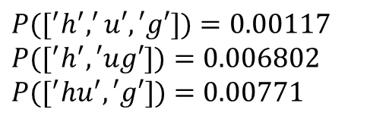
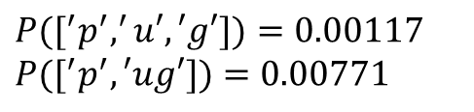
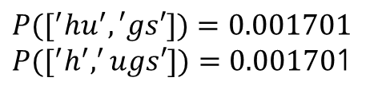
Unigram Tokenizer: Running Example
Compute loss for each subword removal decision
"pug": ["pu", "g"] (score 0.007710)
$P([^{′}p^{′},^{′}u′, ′g′])=0.00117$
$P([^{′}p^{′},′ug′])=0.00771$
Change in likelihood = - 5 * (-log(0.007710)) + 5 * (-log(0.007710)) =0
Removing ‘pu’:
Removing ‘pu’ has no effect
"hug": ["hug"] (score 0.071428)
$P([^{′}h^{′},^{′}u′, ′g′])=0.00117$
$P([^{′}h^{′},′ug′])=0.006802$
$P([^{′}{hu}^{′},′g′])=0.00771$
Removing ‘hug’:
Change in likelihood = -10 * (-log(0.071428))+ 10 * (-log(0.00771))=22.26
"hugs": ["hug", "s"] (score 0.001701)
$P([^{′}{hu}^{′},′gs′])=0.001701$
$P([^{′}h^{′},^{′}ugs′])=0.00170$1
Removing ‘hug’ results in reduction in the likelihood
The token ‘pu’ can be chosen over ‘hug’ for removal as it’s removal has no effect

Slide 31
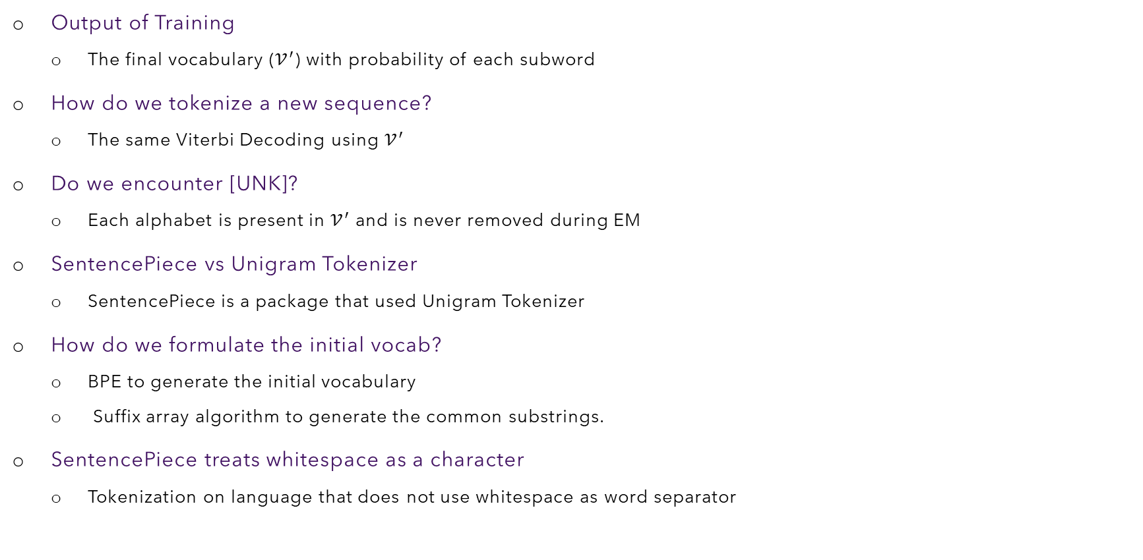
Unigram Tokenizer: Inference
Output of Training
The final vocabulary ($𝒱^{′}$) with probability of each subword
How do we tokenize a new sequence?
The same Viterbi Decoding using $𝒱^{′}$
Do we encounter [UNK]?
Each alphabet is present in $𝒱^{′}$ and is never removed during EM
SentencePiece vs Unigram Tokenizer
SentencePiece is a package that used Unigram Tokenizer
How do we formulate the initial vocab?
BPE to generate the initial vocabulary
Suffix array algorithm to generate the common substrings.
SentencePiece treats whitespace as a character
Tokenization on language that does not use whitespace as word separator

